Slide 1
Core Java 8
Concurrent Patterns In Java

Slide 2
Lesson Objectives
After completing this lesson, participants will be able to
Introducing Executors, What is Wrong with Runnable
Defining Executor Pattern
Executor Pattern Demo
Comparing Runnable and Executor Pattern
Understanding the Waiting Queue of the Executor Service
Wrapping Up Executor Service Pattern
From Runnable to Callable :What Is Wrong with Runnable
Introducing Callable interface to Model Task
Future Objects to Transmit Objects Between Threads
Notes:
This lesson covers the concurrent Pattern in Java . It explains how to create Executor program and implement Concurrent Patterns .
Lesson outline:
Introducing Executors, What Is Wrong with the Runnable Pattern?
Defining the Executor Pattern: A New Pattern to Launch Threads
Defining the Executor Service Pattern, a First Simple Example
Comparing the Runnable and the Executor Service Patterns
Understanding the Waiting Queue of the Executor Service
Wrapping-up the Executor Service Pattern
From Runnable to Callable: What Is Wrong with Runnables?
Defining a New Model for Tasks That Return Objects
Introducing the Callable Interface to Model Tasks
Introducing the Future Object to Transmit Objects Between Threads
Wrapping-up Callables and Futures, Handling Exceptions

Slide 3
Introduction - Executor
Consider the below code snippet :
Runnable task = () -> System.out.println(“Hello World “ );
Thread thread= new Thread(task);
thread.start();
---------------------------------------------------------------------------------
Executor Pattern Aims
to Fix These Issues
1. A task is an instance of Runnable
2. The task is passed to a new instance of Thread
3. The Thread is launched
4. The thread is created on demand ,by user
5. Once the task is done, thread dies
6. Thread are expensive resource . . .
Notes:
A task is an instance of Runnable
The Thread is launched
The Thread is created on demand by user
Once the task is done ,thread dies.
Threads are expensive resource

Slide 4
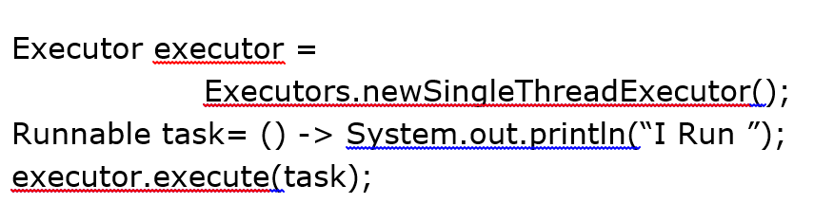
Executor Pattern
How can we improve the use of Threads ,as resources ?
-By creating pools of ready to use threads ,and using them .
Instead of creating a thread with task as a parameter ,we pass a task to the pool of threads ,that will execute it .
We Need 2 patterns :
One to create a pool of Threads
Second one to pass a task to this pool

Slide 5
Executor Service Pattern
public interface Executor {
void execute(Runnable Task);
}
Executor interface is a simple interface to support launching new tasks.
ExecutorService is an extension of Executor
ExecutorService singleThreadExecutor = Executors.newSingleExecutor();
-This will create a pool with only one thread in it .
Notes:
The thread in SingleExecutorService pattern will be kept alive as long as pool is alive.
A pool of Thread is an instance of Executor interface

Slide 6
ExecutorService Pattern
ExecutorService is an extension of Executor
public interface ExecutorService extends Executor{
// 11 more methods..
}
The 2 most used executor services are :
Single Thread Executor
ExecutorService singleThreadExecutor = Executors.newSingleExecutor();
Fixed Thread pool Executor
ExecutorService fixedThreadExecutor= Executors.newFixedThreadPoolExecutor(8);
Notes:
The thread in SingleExecutorService pattern will be kept alive as long as pool is alive.

Slide 7
Executor Service Pattern
Runnable task= () -> System.out.println(“I run” );
Runnable Pattern :
Thread thread= new Thread(task);
thread.start();
Executor Pattern :
Executor executor = new Executors.singleThreadExecutor();
executor.execute(task);
Here we have to create the thread
Thread will be created by Executors
Notes:
The thread in SingleExecutorService pattern will be kept alive as long as pool is alive.

Slide 8
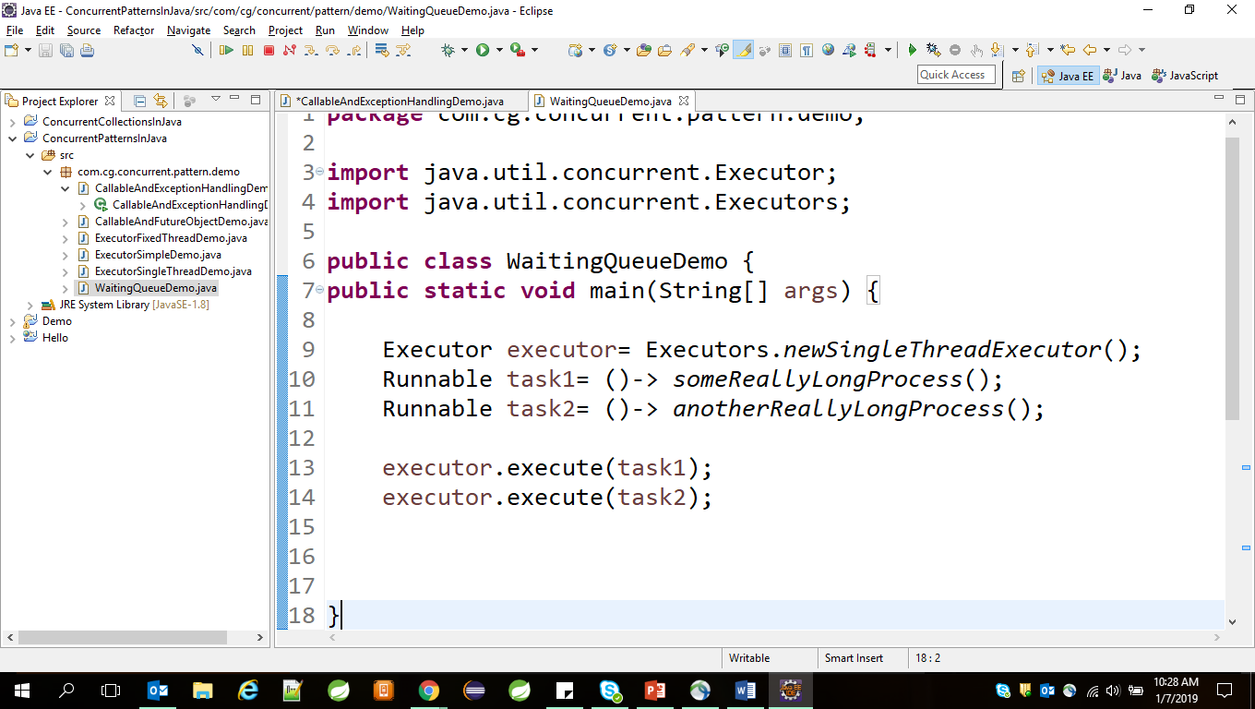
ExecutorService Pattern
Suppose we run this code ,obviously task2 has to wait for task1 to complete.
To Handle this case ,Executor has a waiting queue :
Working of Waiting Queue :
A task is added to waiting queue when no thread is available
The task are executed in the order of their submission .

Slide 9
ExecutorService Pattern –Wrap Up
Building an Executor is more efficient than creating threads on demand.
Executor will create the pool of threads and these threrads will be alive as long as the Executor is alive.
One given thread can execute as many task as we need.
We can pass instances of Runnable to Executor
The Executor has a Waiting Queue to handle multiple requests.
A task can be removed from the waiting Queue

Slide 10
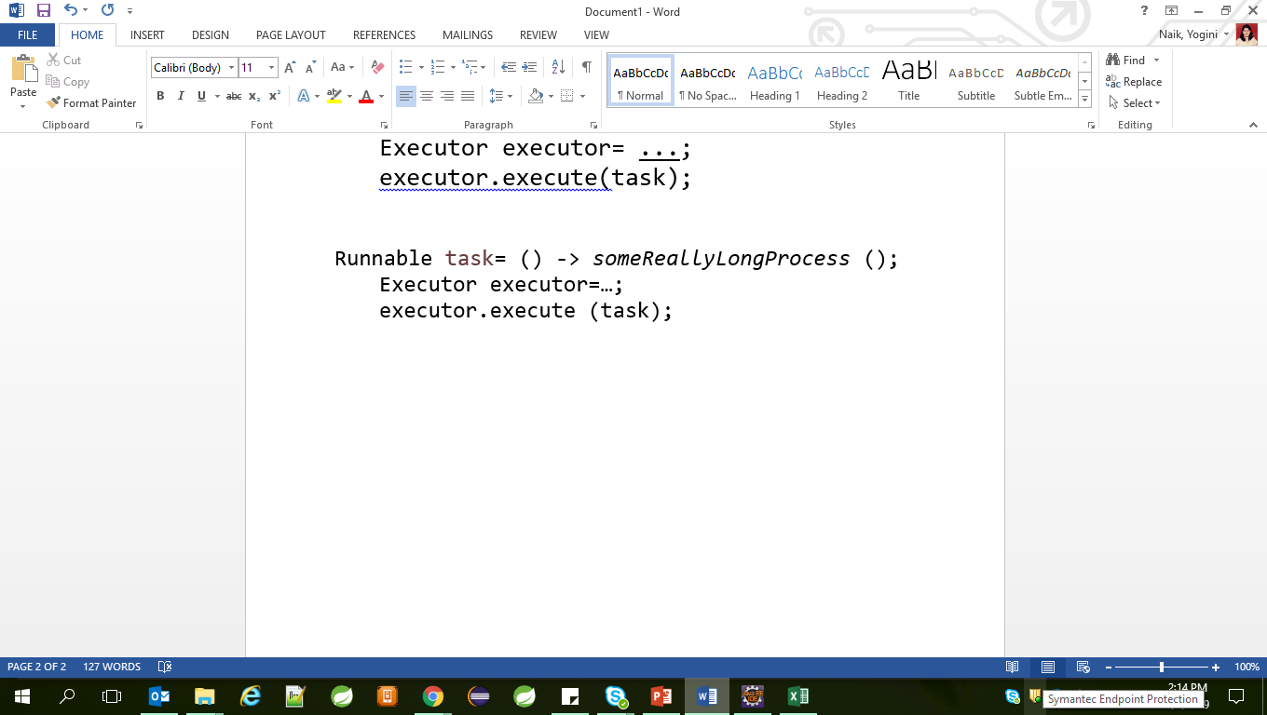
From Runnable to Callable
With Runnable implementation :
A task can not return the result
A task can not throw the exception
There is no way to know whether task is done or not

Slide 11
Callable Introduction
We need a new model for our tasks with below features :
With a method that returns a value
And that can throw exception .
We also need a new Object that acts as bridge between threads
public interface Callable<V>{
V call() throws Exception ;
}

Slide 12
Demo

Slide 13
Introducing the Future Object to Transmit Objects Between Threads
Executor interface does not handle Callable
ExecutorService interface has submit method to handle Callable
Future<T> submit (Callable<T> Task);

Slide 14
How does this Future Object Works?
We create the Callable in main thread and the task which we want to execute .
We pass this task to submit method of executor
ExecutorService will execute this task and produce the result .
This result has to be passed from ExecutorService to Main thread.
Here comes the Future Object for your help.
In fact the Executor will return the Future object which holds the result.

Slide 15
// In main thread
The future object is returned by submit() method call in main thread.
The get() method of future object can be called to return the produced string.
The get() method is blocking until the returning String is available.
Callable<String> task= ()->buildPatientReport();
Future<String> future= executor.submit(task);
String result= future.get();

Slide 16
Lab

Slide 17
Summary
In this lesson, you have learnt the following:
Callable
Executor
Notes:
Add the notes here.

Slide 18
Review Question

